Slide 1
Web Application Interacting with Database Java Database Connectivity
Kiều Trọng Khánh

Slide 2
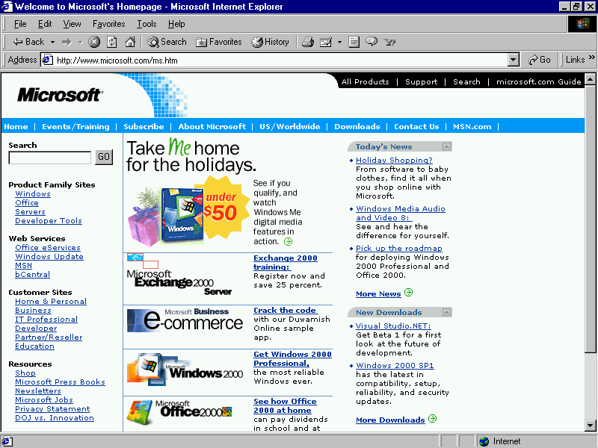
Review
How to build the simple web site using html and servlet?
Break down structure component in building web application
Some concepts
Servlet vs. Java class, Parameter vs. Variable
Form Parameters
Http Protocol
HTTP Methods: GET, POST, …
Servlet Life Cycle (init, service, destroy)
Web Server
Container
1. Send request
C
2. Call
3. Query
DB
DAO
5. Response
4. Render/Send
6. Display
V
Notes:
Phần Filter đọc thêm ở nhà
2

Slide 3
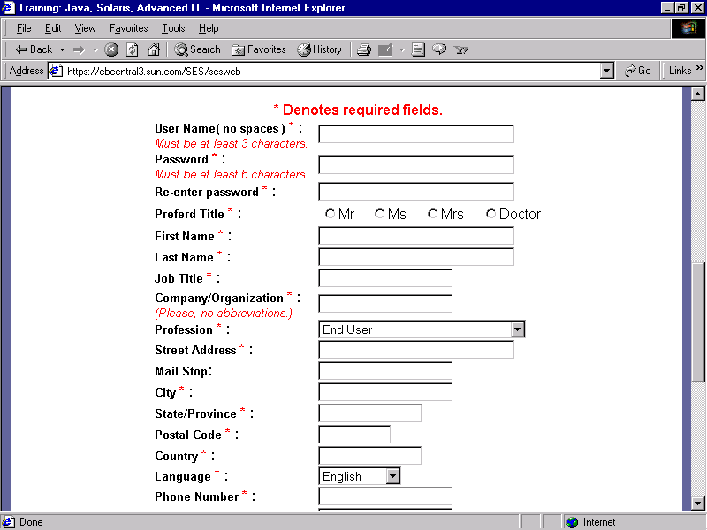
Review
1. Input and click button/link
3. Send request
4. Dispatch to Servlet/Web Container
Web/App Server
Containter
Request Object
5. Container create Req Obj
2. Generate the Request msg
10. Send response
6. Forward
Response Object
Resources
9. Create Response Msg
8. Set Val
OS
7.retrieve data (if any)
DB
Client
Server
Notes:
Phần Filter đọc thêm ở nhà
3

Slide 4
Review
1. Input and click button/link
3. Send request
4. Dispatch to Servlet/Web Container
Web/App Server
Containter
Request Object
5. Container create Req Obj
2. Generate the Request msg
10. Send response
6. Forward
Response Object
Resources
9. Create Response Msg
8. Set Val
OS
7.retrieve data (if any)
DB
Client
Server
Notes:
Phần Filter đọc thêm ở nhà
4

Slide 5
Objectives
How to access database from web application?
JDBC
Relational Database Overview
JDBC and JDBC Drivers
JDBC Basics: Processing SQL Statements
Implement CRUD application using MS SQL

Slide 6
Objectives
Web based App - PBL
Web
Day 1, 2, 3 – Login
Servlet
Day 7, 8, 9 – Search
Break Down
Day 10, 11 – MVC2
JSP
Day 12, 13, 14, 15 – CUD, Shopping Carts
Sessions
Day 16, 17 – Login
JavaBeans
Day 18, 19, 20 – CRUD
MVC 2 Complete - JSTL - Taglib
Day 21, 22, 23 – Filter
MVC2 Using Filter as Controller
4, 5, 6 – JDBC
Login

Slide 7
Overview DB vs. DBMS
Databases
Are collection of related data which are stored in secondary mass storage and are used by some processes concurrently.
Are organized in some ways in order to reduce redundancies.
DBMS: Database management system
Is a software which manages some databases.
Supports ways to users/processes for creating, updating, manipulating on databases and security mechanisms are supported also.
DBMS libraries (C/C++ codes are usually used) support APIs for user programs to manipulate databases.

Slide 8
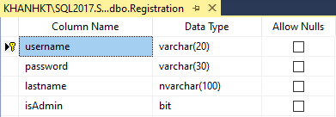
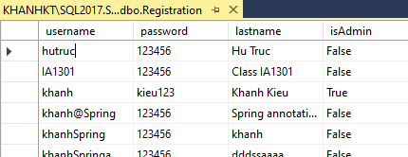
Overview Relational DB
Presents information in tables with rows and columns.
A table is referred to as a relation in the sense that it is a collection of objects of the same type (rows).
A Relational Database Management System (RDBMS)
Handles the way data is stored, maintained, and retrieved.
Ex: MS Access, MS SQL Server, Oracle

Slide 9
RDBMS Structure Query Language (SQL)
Common DML – Data Manipulating Language queries.
SELECT columns FROM tables [WHERE condition]
UPDATE table SET column=value,… WHERE condition
DELETE FROM table WHERE condition
INSERT INTO table (col1, col2,…) VALUES ( val1, val2,…)

Slide 10
JDBC Overview
Java Database Connectivity
Is an application programming interface (API) for the programming language Java, which defines how a client may access a database
Provides access to DB and performs DB operations – CRUD(Create, Read, Update, Delete)

Slide 11
JDBC API
The JDBC™ API
Was designed to keep simple things simple such as executing common SQL statements, and performing other objectives common to database applications
Is a Java API that can access any kind of tabular data, especially data stored in a Relational Database.
Executes simple SQL queries in the Java code to retrieve data from database
The java.sql.* and javax.sql.* package provides database access in Java through directly or indirectly (Data source – flexible), and provides classes and interfaces that are used to interact with the database

Slide 12
JDBC API
JDBC APIs has 02 parts in the java.sql package
Part | Details | Purposes
JDBC Driver | DriverManager class | java.lang.Class.forName(DriverClass) will dynamically load the concrete driver class, provided by a specific provider for a specific database. This class implemented methods declared in JDBC interfaces. The class DriverManager will get a connection to database based on the specific driver class loaded.
JDBC API | Interfaces: Connection, Statement ResultSet DatabaseMetadata ResultSetMetadata Classes SQLException | For creating a connection to a DBMS For executing SQL statements For storing result data set and achieving columns For getting database metadata For getting resultset metadata
Refer to the java.sql package for more details in Java documentation

Slide 13
JDBC API
Java App.
Connection con
Statement stmt
ResultSet rs
DriverManager
executeQuery()
createStatement()
Process rs
getConnection()
Specific JDBC Driver implement interfaces
(loaded dynamically by java.lang.Class)
Database
Model of a JDBC App.

Slide 14
JDBC API
DBMS provider/developer will supply a package in which specific classes implementing standard JDBC driver (free).
Based on characteristics of DBMSs, four types of JDBC drivers are: driver dịch từ java sang sql
Type 1: JDBC ODBC
Type 2: Native API
Type 3: Network Protocol
Type 4: Native Protocol
Type 1 and Type 4 are populated.

Slide 15
JDBC Drivers
Translates Java statements to SQL statements
Helps applications to interact with the database, using Java’s built-in Driver Manager
JDBC driver manager maintains a list of drivers created for different databases
JDBC drivers connect the Java application to the driver specified in the Java program
The four types of JDBC drivers are:
Type 1: JDBC ODBC
Type 2: Native API
Type 3: Network Protocol
Type 4: Native Protocol
Type 1 & Type 4 is populated

Slide 16
JDBC Type 1-Driver: JDBC-ODBC Bridge
Application
Java Application
Microsoft Technology
Type I JDBC-ODBC Bridge
SQL Command
Result Set
Mapping
<Datasource name, Data file>
MS ODBC Driver
MS Access Driver
MS Excel Driver
MS SQL Srv Driver
Oracle Driver
…
Database
Database
Database
Database

Slide 17
JDBC Type 1-Driver: JDBC-ODBC Bridge
This package is in the JDK as default.
Translates JDBC APIs to ODBC APIs
Enables the Java applications to interact with any database supported by Microsoft.
Provides platform dependence, as JDBC ODBC bridge driver uses ODBC
JDBC-ODBC bridge is useful when Java driver is not available for a database but it is supported by Microsoft.
Disadvantages
Platform dependence (Microsoft) chỉ hoạt động những cái trong microsoft
The performance is comparatively slower than other drivers
Require the ODBC driver and the client DB to be on the server.
Usage: DSN is registered to use connecting DB (a data source is declared in Control Panel/ODBC Data sources)

Slide 18
JDBC Type 2-Driver: Native API
Provides access to the database through C/C++ codes.
Developed using native code libraries
Native code libraries provide access to the database, and improve the performance
Java application sends a request for database connectivity as a normal JDBC call to the Native API driver
Establishes the call, and translates the call to the particular database protocol that is forwarded to the database
Application
Java Application
Type II JDBC Driver
SQL Command
Result Set
Native Database Library
Proprietary Protocol
Database

Slide 19
JDBC Type 3-Driver: Network Protocol
Use a pure Java client and communicate with a middleware server using a database-independent protocol.
The middleware server then communicates the client’s requests to the data source
Manages multiple Java applications connecting to different databases
Application
Java Application
Type III JDBC Driver
Result Set
Middleware
JDBC
Database

Slide 20
JDBC Type 4-Driver: Native Protocol
Communicates directly with the database using Java sockets
Improves the performance as translation is not required
Converts JDBC queries into native calls used by the particular RDBMS
The driver library is required when it is used and attached with the deployed application (sqlserver 2000: mssqlserver.jar, msutil.jar, msbase.jar; sqlserver 2005: sqljdbc.jar; jtds: jtds.jar …)
Independent platform
Application
Java Application
Type IV JDBC Driver
SQL command
Result Set
use Proprietary protocol
Database

Slide 21
JDBC Summary

Slide 22
JDBC API Download Driver & Configure RDBMS
Download:
Download Microsoft JDBC Driver for SQL Server - SQL Server | Microsoft Docs
Configuration
Using SQLServer Configuration Manager
Or, services.msc
Configure ports, protocol

Slide 23
JDBC API
How to connect DB
Required
RDBMS: SQL Server
Driver Connection: sqljdbc4.jar
Steps
Load Driver
using Class.forName method
Driver string: com.microsoft.sqlserver.jdbc.SQLServerDriver
Exception: ClassNotFoundException
Create connection String
protocol:server://ip:port;databaseName=DB[;instanceName=Instance]
Open connection
Connection con = DriverManager.getConnection(url, “user", “pass");
Exception: SQLException

Slide 24
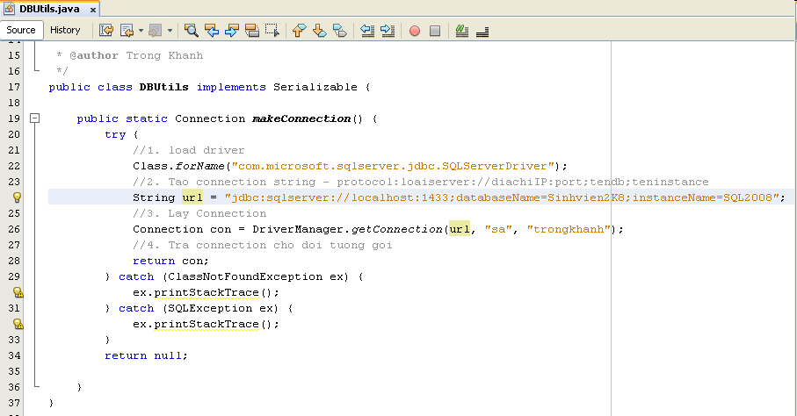
JDBC API
How to connect DB
Implementation

Slide 25
JDBC API
How to access DB using JDBC API
Required
DB is connected
Steps
Connect DB using method that you are built
Check available DB connection
Create SQL String using DML
Create Statement
Statement
PrepareStatement (pass Parameter with ?)
CallableStatement
Execute Query to get ResultSet
Process the ResultSet
Notes: must closed all objects that are created after process had finished

Slide 26
JDBC API Statements
Sends queries and command to the database
Ex: “Select * From Registration”
Is Created from the Connection object
Statement stmt = con.createStatement();
Statement stmt = con.createStatement(rsType, rsConcurrency)
rsType: TYPE_FORWARD_ONLY, TYPE_SCROLL_INSENSITIVE, TYPE_SCROLL_SENSITIVE
rsConcurrency: CONCUR_READ_ONLY, CONCUR_UPDATABLE
There are 03 types of Statement
Statement
PreparedStatement (prepareStatement). Ex:
Select * From Registration Where uName = ?
CallableStatement (prepareCall()). Ex: {stpInsert (?)}

Slide 27
JDBC API Prepared Statements
To execute a Statement object many times, it normally reduces execution time to use a PreparedStatement object instead.
PreparedStatement stm = con.prepareStatement(sql);
Supplying Values for PreparedStatement Parameters:
To supply values to be used in place of the question mark placeholders (if there are any) before a PreparedStatement object is executed.
One of the setXXX methods is called in the PreparedStatement class.
stm.setXXX(Cardinal number, values);
Ex:
stm.SetInt(1, 5);
stm.SetString(2, “abc”);

Slide 28
JDBC API Callable Statements
To execute the stored procedure, the Callable Statement is used
CallableStatement cs = con.prepareCall("{call stored_p_name(?)}");

Slide 29
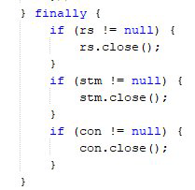
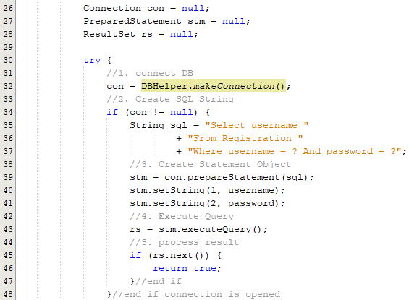
JDBC API
How to access DB
Implementation

Slide 30
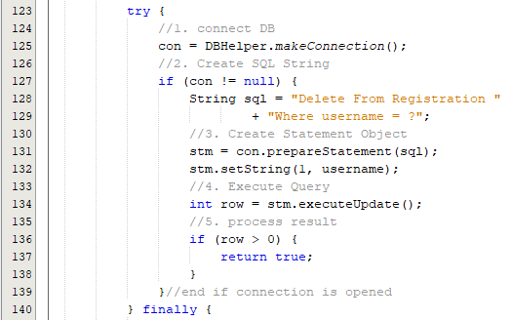
JDBC API
How to access DB using
Implementation

Slide 31
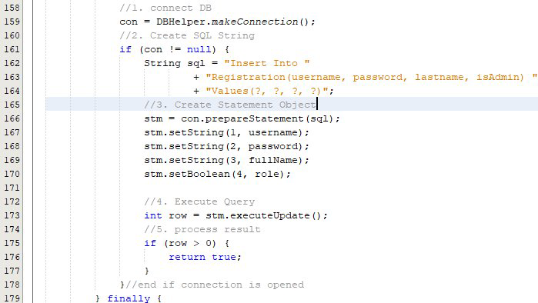
JDBC API
How to access DB
Implementation

Slide 32
JDBC API Execute Query
Used to execute statement and get data from DB
The executeQuery() method
Is used to Query commands and stored procedure. Ex:
String strSQL = “Select * From Registration”;
Returns an object of type ResultSet
ResultSet rs = stmt.executeQuery(strSQL);
The executeUpdate() method
Is used to Insert, Update, or Delete commands. Ex
String strSQL = “Insert into Registration Values(“Aptech”, “Aptech”);
Returns the row of executed validation.
int nRow = stmt.executeUpdate(strSQL);
The execute() method
Is use to create and delete DB objects as table, DB ...Ex:
String strSQL = “Drop table Registration”;
stmt.execute(strSQL);

Slide 33
JDBC API Process the Results
The ResultSet class implements a collection of type Set and allows to use it to process one row at the time
Apply to the ResultSet object
The getXxx (cardinal number/ field name string) of the ResultSet object is used to get the field value.
Cardinal number starts with 1
Xxx is a DataType of the selected field
The next() method of the ResultSet object is used to process the results from the DB
Ex: while(rs.next()) (Point the cursor next row) {
rs.getInt(1) or rs.getInt(“userId”);
rs.getString(1) or rs.getString(“username”); }
Notes: The field must be accessed in the order
The 2D Resultset support the access methods to DB as first, isFirst, last, ...
There is a class ResultSetMetaData that helps to determine the number, names and types of column in the ResultSet
Close the connection after used: The close() method is used. Ex: con.close();

Slide 34
JDBC API Some methods of ResultSet
Methods | Description
getString() | Takes column number as an argument and returns value from the specified column number as a string to the ResultSet object
getInt() | Takes column number as an argument and returns the value from the specified column number as an integer to the ResultSet object
getFloat() | Takes column number as an argument and returns the value from the specified column number as float type to the ResultSet object
getDate() | Takes column number as an argument and returns the value from the specified column number as java.sql.Date to the ResultSet object
findColumn() | Takes a column name as a string parameter and returns the column index of the specified column name
wasNull() | Returns true if the last column value read was SQL NULL
getMetaData() | Returns the information about the columns of ResultSet object in a ResultSetMetaData class

Slide 35
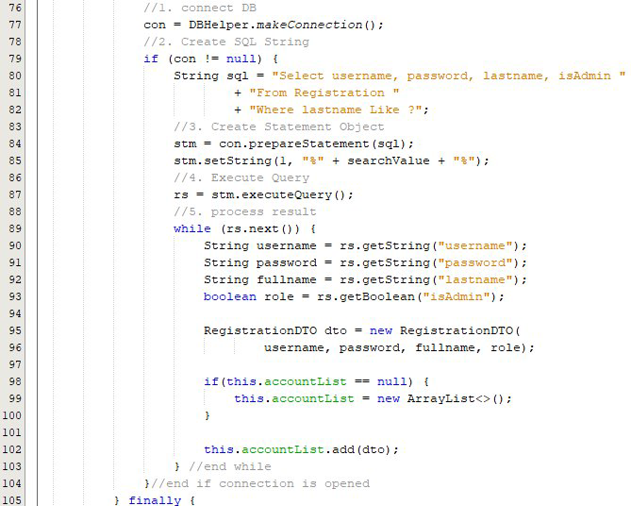
JDBC API

Slide 36
JDBC API Some method of ResultSetMetaData
Methods | Syntax | Description
getColumnCount() | int getColumnCount() | Returns the number of columns in the ResultSet object
getColumnName() | String getColumnName (int column) | Takes column number as a parameter and returns the designated column name
getColumnType() | int getColumnType (int column) | Takes column number as a parameter and returns the designated column’s SQL type from java.sql.Types. The types include Array, char, Integer, Date, and Float
isReadOnly() | boolean isReadOnly (int column) | Takes the column number as a parameter and returns true if the designated column is not writable
isSearchable() | Boolean isSearchable (int column) | Takes column number as a parameter and returns true if the specified column can be used in where clause.
isNullable() | int isNullable (int column) | Returns the nullability status of the specified column. The nullability status includes, columnNullable, columnNoNulls, and columnNullableUnknown

Slide 37
Summary
How to access database from web application?
JDBC
Relational Database Overview
JDBC and JDBC Drivers
JDBC Basics: Processing SQL Statements
Implement CRUD application using MS SQL
Q&A

Slide 38
Exercises
Do it again all of demos
Using servlet to write the programs as the following requirement
Present the Login form (naming LoginServlet) with title Login, header h1 – Login, 02 textbox with naming txtUser and txtPass, and the Login button
Rewrite above Login application combining with DB
Writing the ColorServlet that presents “Welcome to Servlet course” with yellow in background and red in foreground
Writing the ProductServlet includes a form with a combo box containing Servlet & JSP, Struts & JSF, EJB, XMJ, Java Web Services, and the button with value Add to Cart

Slide 39
Next Lecture
How to deploy the Web Application to Web Server?
Web applications Structure
Request Parameters vs. Context Parameters vs. Config/Servlet Parameters
Application Segments vs. Scope
How to transfer from resources to others with/without data/objects?
Attributes vs. Parameters vs. Variables
Redirect vs. RequestDispatcher
RequestDispatcher vs. Filter

Slide 40
Next Lecture
Web based App - PBL
Web
Day 1, 2, 3, 4, 5, 6 – Login
Servlet, JDBC
Day 7, 8, 9 – Search
Break Down
Day 10, 11 – MVC2
JSP
Day 12, 13, 14, 15 – CUD, Shopping Carts
Sessions
Day 16, 17 – Login
JavaBeans
Day 18, 19, 20 – CRUD
MVC 2 Complete - JSTL - Taglib
Day 21, 22, 23 – Filter
MVC2 Using Filter as Controller

Slide 41
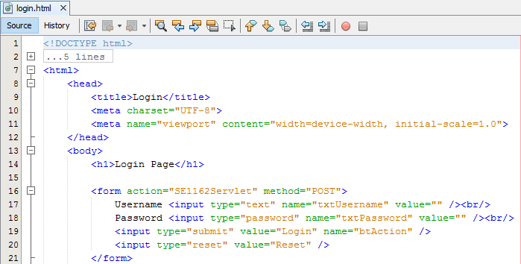
Appendix – Build The Simple Web Login Page

Slide 42
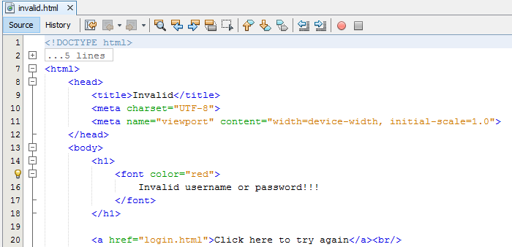
Appendix – Build The Simple Web Invalid Page

Slide 43
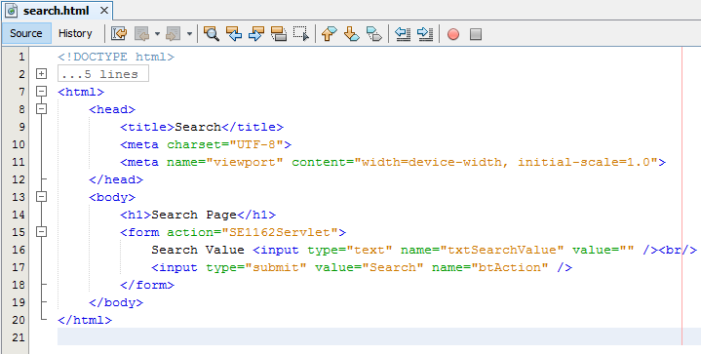
Appendix – Build The Simple Web Search Page

Slide 44
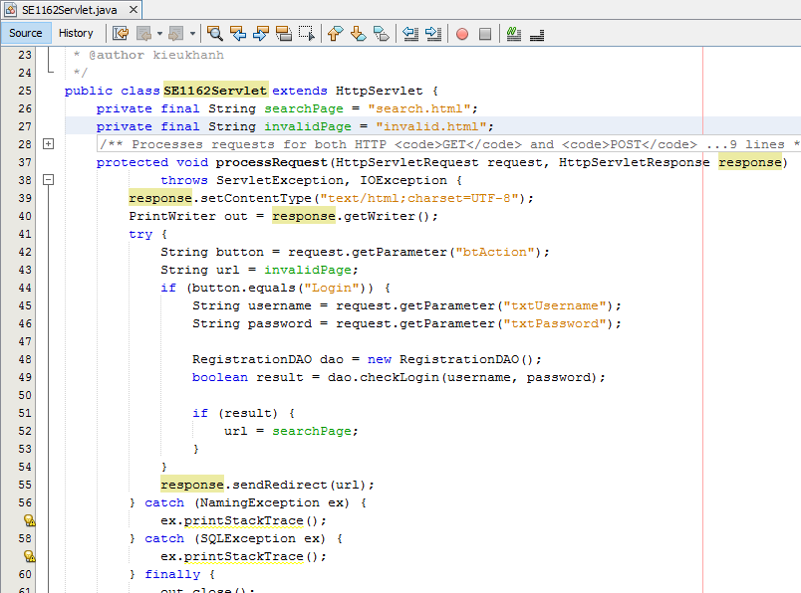
Appendix – Build The Simple Web Servlet

Slide 45
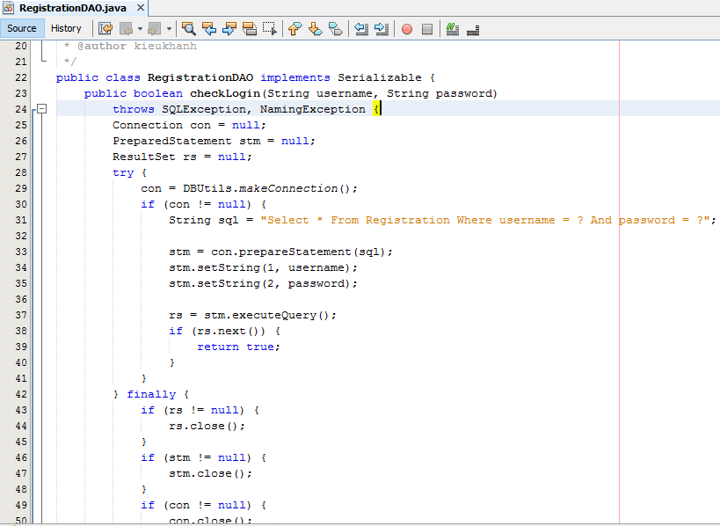
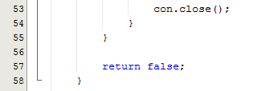
Appendix – Build The Simple Web DAO

